Slide 1
Compiler Design
Lexical Analysis
Saeed Parsa
Room 332,
School of Computer Engineering,
Iran University of Science & Technology
parsa@iust.ac.ir
Winter 2021

Slide 2
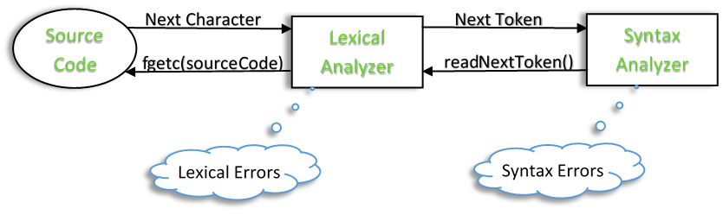
What is Lexical Analyzer?
The lexical analyzer is usually a function that is called by the parser when it needs the next token.
The main task of the lexical analyzer is to read the input characters of the source program, group them into lexemes, and produce as output a token for each lexeme in the source program.

Slide 3
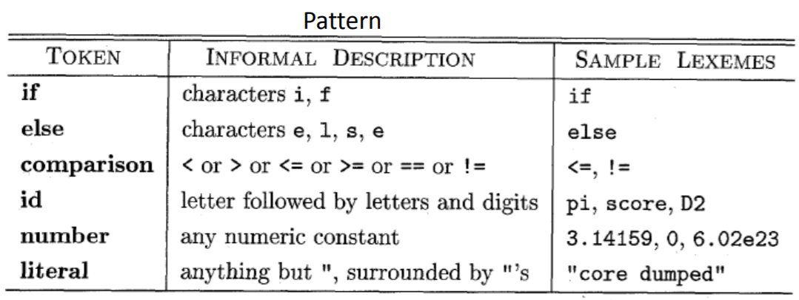
What is Lexical Analyzer?
Lexeme: sequence of characters in source program matching a pattern.
Keywords; Examples-for, while, if etc.
Identifier; Examples-Variable name, function name, etc.
Operators; Examples '+', '++', '-' etc.
Separators; Examples ',' ';' etc.
Read, Section 3.1.2 in page 111 of Aho book.

Slide 4
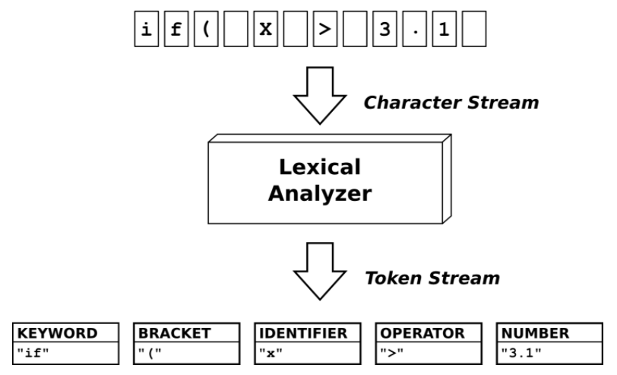
What is Lexical Analyzer?

Slide 5
What is Lexical Analyzer?
Input & Output structure:
Input:
Text source;
source = fopen(input_file , ”R+”);
Output structure:
typedef struct Token{
int row; // 1- Row number of the lexicon
int col; // 2- Column number of the lexicon
int BlkNo ; // 3- Nested block no.
enum Symbols type; // 4- the lexicon code
char Name [30]; // 5- Lexicon
} Token-type ;

Slide 6
What is Lexical Analyzer?
Output structure: Nesting block no.
The names of the variables alone are not enough to determine and distinguish them from each other, but to determine a word, its enclosing block nesting number is needed.
Example:
{ int I ;
I=5 ;
{ int I ;
I=6 ;
printf(“2nd blk %d“, I);
}
printf(“ \n 1st blk %d“, I);
}

Slide 7
What is Lexical Analyzer?
Output structure:
To each kind of lexeme a different code is assigned. Enumerated data types male it possible to name constants.
For instance on the following enum definition, the first constant S_Program = 0 represents the program keyword, and the S_Eq = 2 represents the equal sign.

Slide 8
What is Lexical Analyzer?
Output structure:
typedefe enum Symbols
{ S_Program, S_Const, S_Eq, S_Semi, S_Id, S_No, S_Type,
S_Record, S_End, S_Int, S_Real, S_Char, S_Array, S_String,
S_Begin, S_Var, S_Colon, S_ParBaz, S_ParBast, S_Set,
S_of,S_BrackBaz, S_BrackBast, S_Case, S_ConstString,
S_Function, S_Procedure, S_Begin, S_Dot, S_Comma,
S_If, S_Then, S_Else, S_While, S_Do, S_Repeat, S_Until,
S_For, S_Add, S_Sub, S_Div, S_Mul, S_Mod, S_Lt, S_Le,
S_Gt, S_Ge, S_Gt, S_Ne, S_Not, S_And, S_Or
};

Slide 9
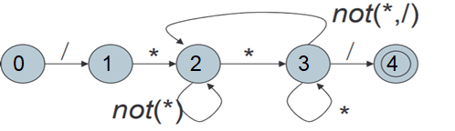
Implementation
Lexical Analysis can be implemented with the Finite State Automata (FSA).
A Finite State Automaton has
A set of states
• One marked initial
• Some marked final
A set of transitions from state to state
• Each labeled with an alphabet symbol or ε
Operate by beginning at the start state, reading symbols and making indicated transitions
When input ends, state must be final or else reject
Note: This FSA represents “Comments” in CPP.

Slide 10
Implementation
Example:
Blank | \t | \n
Source:
Input: /* ab1-***+*/
State: 000122222333234 Accept
Input: /- aaaaa */
State: 0001 Error
Input: /* ab***-
State: 00012223332 Infinite loop

Slide 11
Finite State Automata (FSA)
A Finite State Automaton is a recognizer or acceptor of regular Language.
The word finite is used because the number of possible states and the number of symbols in alphabet sets are finite.
In Greek, automaton means self-acting.
Formally, finite automaton is a 5 tuple machine, denoted by M, where:
M=(Q,Σ,δ,q0,F).
Q is a finite set of states.
Σ is the finite input alphabets.
Δ is the transition function.
q0 indicates start state. q0⊆Q
F is the set of final or accepting states. F⊆Q.
https://www.researchgate.net/publication/311251505_An_exploration_on_lexical_analysis

Slide 12
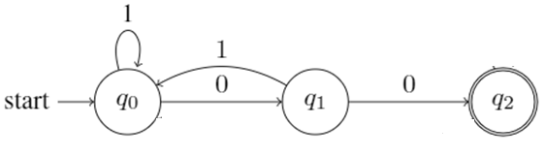
An example of a DFA
This Figure depicts an example of Deterministic Finite Automata.
Formal definition is
M=(Q,Σ,δ,q0,F).
Q={q0,q1,q2}set of all states.
Σ={0,1},δ is given in transition table,
q0 is start or initial state,
F={q2}.
Language is defined as L(M) ={w/w ends with 00}, w can be combination of 0’s and 1’s which ends with 00. (2) (PDF)
https://www.researchgate.net/publication/311251505_An_exploration_on_lexical_analysis

Slide 13
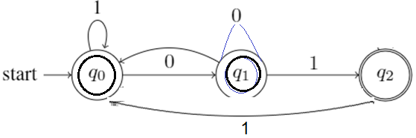
An example of a DFA
Language is defined as L(M) ={w/does not include 010}, w can be combination of 0’s and 1’s which does not include the 010 substring.
Formal definition is
M=(Q,Σ,δ,q0, F).
Q={q0,q1,q2}set of all states.
Σ={0,1}, δ is given in transition table,
q0 is start or initial state,
F={q0, q1, q2}.

Slide 14

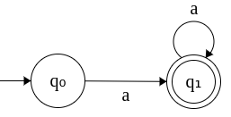

An example of a DFA
DFA that accepts exactly one a. Σ = {a}.
DFA that accepts at least one a. Σ = {a}.
DFA that accepts even number of a's. Σ = {a}.
https://swaminathanj.github.io/fsm/dfa.html

Slide 15
Transition diagrams
DFA starts consuming input string from q0 to reach the final state.
In a single transition from some state q, DFA reads an input symbol, changes the state based on δ and gets ready to read the next input symbol.
If last state is final then string is accepted otherwise it is rejected.
A finite automaton, (FA) consists of a finite set of states and set of transitions from state to state that occur on input symbols chosen from an alphabet S.
For each input symbol if there is exactly one transition out of each state then M is said to deterministic finite automaton.
A directed graph, called a transition diagram, is associated with a finite automaton as follows.
The vertices of the graph correspond to the states of the FA.
https://shodhganga.inflibnet.ac.in/bitstream/10603/77125/8/08_chapter%201.pdf

Slide 16
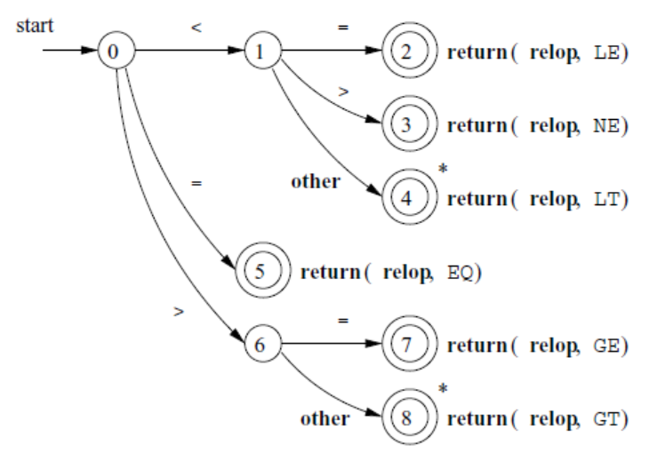
Transition diagrams
The following Figure is a transition diagram that recognizes the lexemes matching the token relop (relational operators).
Note, however, that state 4 has a * to indicate that we must retract the input one position
Page 131 of AHO book

Slide 17
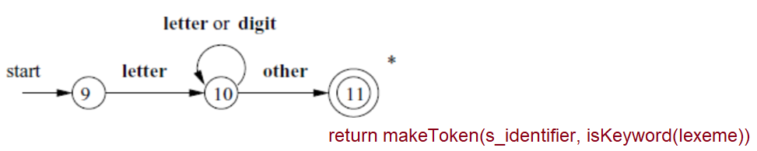
Recognizing Identifiers
Recognizing keywords and identifiers presents a problem.
Usually, keywords like if or then are reserved (as they are in our running example), s
So they are not identifiers even though they look like identifiers.
After an identifier, is detected, isKeyword() is invoked to check whether the detected lexeme is a keyword.
Page 132 of AHO book

Slide 18
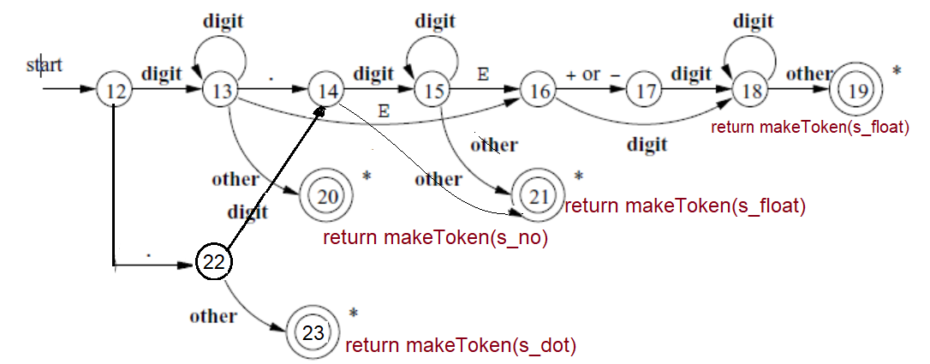
Recognizing Numbers
Different types of numbers:
23.32
12
12.
.13
12.5E-8
Page 133 of AHO book

Slide 19
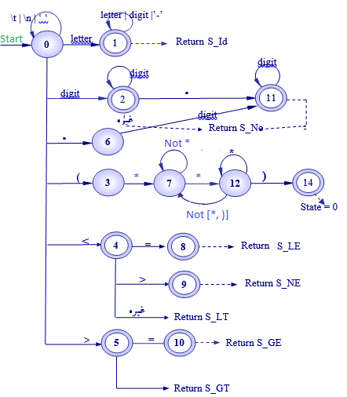
Recognizing all lexicons
Lexical rules of a language can be defined in terms of a DFA.
In state zero whitespaces are ignored.
State 1 recognizes identifiers.
After an identifier, is detected, isKeyword() is invoked to check whether the detected lexeme is a keyword.

Slide 20
Architecture of a Transition-Diagram-Based Lexical Analyzer
There are several ways that a collection of transition diagrams can be used to build a lexical analyzer.
Regardless of the overall strategy, each state is represented by a piece of code.
We may imagine a variable state holding the number of the current state for a transition diagram.
A switch based on the value of state takes us to code for each of the possible states, where we find the action of that state.
Often, the code for a state is itself a switch statement or multiway branch that determines the next state by reading and examining the next input character.
You may write a program to convert a state transition diagram to a program.
Page 134 of AHO book

Slide 21
Converting the state diagram to a lexical analysis program
struct TokenType lexeicalAnalyser ( FILE *Source )
{
enum Symbols LexiconType ; //Type of Lexeme
char NextChar, NextWord[80 ] ; //Next char & next word
int State, Length; // State no. in automata
static char LastChar = ‘\0’; // Extra char read In the last call
static int RowNo =0, ColNo = 0; // Row and column no.
State = 0 ; // Start state no. is zero
Length = 0 ; //Length of the detected lexeme
while( ! feof ( Source )) // While EOF source not encountered
{
if ( LastChar ) // if extra char was read in last call
Nextchar = LastChar; LastChar = ‘\0’ ;} // Retreat the character
else
NextChar = fgetc ( Source ) ; // Read next character
NextWord[Length++] = NextChar; // Begin to make the next lexeme
state | Length | NextChar | LastChar | NextWord
0 | 1 | v | ‘\0’ | v
1 | 2 | o | ‘\0’ | vo
1 | 3 | i | ‘\0’ | voi
1 | 4 | d | ‘\0’ | void
1 | 5 | ҍ | ‘\0’ | voidҍ

Slide 22
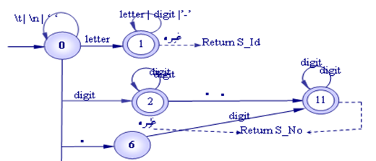
Converting the state diagram to a lexical analysis program
switch State // Operate dependent on the State
{
case 0: // Recognizing numbers.
if (NextChar == ‘\n‘)
{RowNo++ ; ColNo = 0; }
else ColNo++;
if (Nextchar == ‘ ‘ || Nextchar = = ‘ \ t ‘ || Nextchar == ‘ \ n ‘)
Length = 0;
else if (( Nextchar < = ‘z‘ && Nextchar > = ‘a‘ ) ||
( Nextchar < = ‘Z‘ && Nextchar > = ‘A‘ ))
State = 1;
else if ( Nextchar < = ‘9‘ && Nextchar > = ‘0‘ )
State = 2 ;
else if ( Nextchar = = ‘ ( ‘ ) State = 3;
else if ( Nextchar = = ‘ < ‘ ) State = 4
else if ( Nextchar = = ‘ > ‘ ) State = 5
else LexerError(NextWord, Length);
break ; // End of no. detection
state | Length | NextChar | LastChar | NextWord
0 | 1 | v | ‘\0’ | v
1 | 2 | o | ‘\0’ | vo

Slide 23
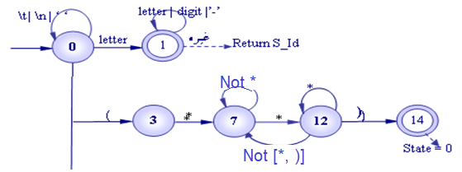
Converting the state diagram to a lexical analysis program
//switch State // Operate dependent on the State
//{
case 1 : // Recognizing Identifiers
if (Isalpha(Nextchar) || Isdigit(Nextchar) || NextChar == ‘_’)
state = 1;
else {
Lastchar = Nextchar ; NextWord[--Length] = ‘\0’;
return MakeToken(IsKeyWord(NextWord));
}
break ;
case 3 : …
} // End of switch
} // End of while
state | Length | NextChar | LastChar | NextWord
0 | 1 | v | ‘\0’ | v
1 | 2 | o | ‘\0’ | vo
1 | 3 | i | ‘\0’ | voi
1 | 4 | d | ‘\0’ | void
1 | 5 | ҍ | ҍ | Void\’\0’ “void”

Slide 24
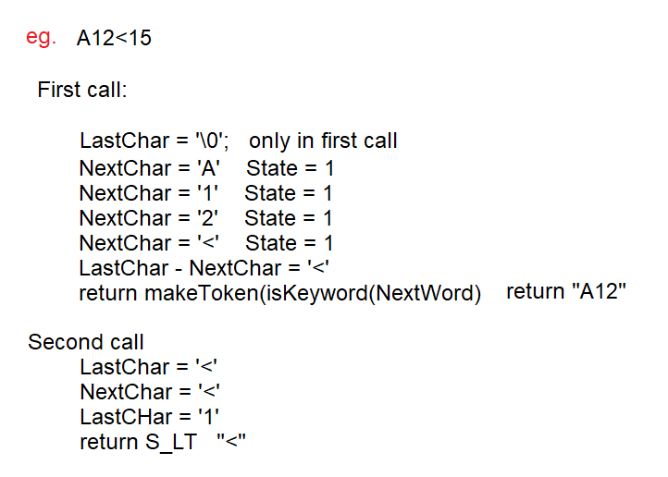
Example

Slide 25
Converting the state diagram to a lexical analysis program
enum Symbols isKeyWord(char *key) {
int I ;
struct KeyType{
char *key;
enum Symbols Type
}
KeyTab[] = { “if’, S_If,
“while”, S_While,
“then”, S_Then,
“else”, S_Else,
“integer”, S_Integer,
“type”, S_Type,
“function”, S_Function,
0, 0};
for(I=0; KeyTab[I].key && strcmp(KeyTab[I].key, Key); I++);
if(KeyTab[I].key) return KeyTab[I].Type;
return S_Identifier;
} // EOF IsKeyWord
The isKeyword method determines whether a given identifier, key, is a keyword.

Slide 26
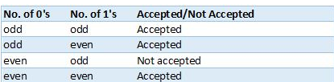
Example 1
Design DFA which with ∑ = {0, 1} accepts either even number of 0s or odd number of 1s. Write the code for a lexical analyzer based on the designed DFA.
We can make four different cases that are:
00
0
01
0
1
1
1
00010101010 not acceptable
acceptable
00 acceptable
0010101 acceptable
1
10
0
11
0

Slide 27
Example 1-2
switch State // Operate dependent on the State
{
case 0: // even no. 0s & even no. 1s.
if (NextChar == ‘\n‘)
{RowNo++ ; ColNo = 0; }
else ColNo++;
if (Nextchar == ‘ ‘ || Nextchar = = ‘ \ t ‘ || Nextchar == ‘ \ n ‘)
Length = 0;
else if (( Nextchar == ‘1‘) State = 2;
else if (( Nextchar == ‘0‘) State = 1;
else return “accepted”;
break ; // End of no. detection
‘ ‘ | \t | \n
0
0
1
0
1
1
1
case 3: // even no. 0s & odd no. 1s
if (( Nextchar == ‘1‘) State = 1;
else if (( Nextchar == ‘0‘) State = 2;
else return “accepted”;
break ; // End of no. detection
1
2
0
3
0

Slide 28
Example 1-3
switch State // Operate dependent on the State
{
case 1: // odd no. 0s & even no. 1s
if (( Nextchar == ‘1‘) State = 3;
else if (( Nextchar == ‘0‘) State = 0;
else LexerError();
break ; //
‘ ‘ | \t | \n
0
0
1
0
1
1
case 2: // odd no. 0s & odd no. 1s
if (( Nextchar == ‘1‘) State = 1;
else if (( Nextchar == ‘0‘) State = 2;
else return “accepted”;
break ; // End of no. detection
} //End of switch
1
1
2
0
3
0

Slide 29
Example 2
Design DFA which with ∑ = {a, n} accepts strings with at least two a's and one b.
q0
a
q1
q2
a
a
b
b
b
q3
q4
q5
a
a
a,b
b
b

Slide 30
Exercise
Design a DFA with ∑ = {0, 1} accepts those string which do not starts with “10” and ends with 0. write a lexical analyzer program to implement the automata..
Design a deterministic finite automata(DFA) for accepting the language:
L = {(a^{n} b^{m}) | m+n=even}.
Design a DFA for accepting numbers in base 3 whose sum of digits is 5.

Slide 31
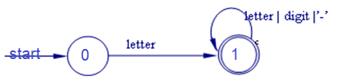
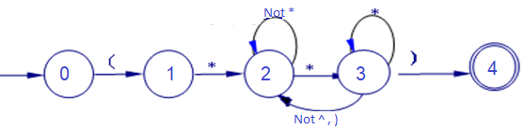
Regular expressions
By definition, a regular expression is a pattern that defines a set of character sequences.
Lexical rules may be defined in terms of regular expressions and in terms of deterministic finite automata.
Examples:
identifier : letter (letter | digit | ‘_’)* ;
Comment : ‘(‘* ( ( r | *+ s ) * r ) * *+ ‘)’ ;
r : all characters apart form *
S; All characters apart from * and ‘)’
Page 128 of AHO book

Slide 32
Lexical rules in ANTLR
Identifiers
A basic identifier is a nonempty sequence of uppercase and lowercase letters.
ID : ('a'..'z'|'A'..'Z')+ ; // match 1-or-more upper or lowercase letters
As a shorthand for character sets, ANTLR supports the more familiar regular
expression set notation:
ID : [a-zA-Z]+ ; // match 1-or-more upper or lowercase letters
Keywords
Rule ID could also match keywords such as enum, if, while, then and for, which means there’s more than one rule that could match the same string.
ANTLR lexers resolve ambiguities between lexical rules by favoring the rule specified first. That means your ID rule should be defined after all of your keyword rules,

Slide 33
Lexical rules in ANTLR
Identifiers:
/*Fragments*/
Identifier
: Identifiernondigit
(Identifiernondigit | DIGIT)*
;
fragment Identifiernondigit
: NONDIGIT
| Universalcharactername
;
fragment NONDIGIT
: [a-zA-Z_]
;
fragment DIGIT
: [0-9]
;
fragment Universalcharactername
: '\\u' Hexquad
| '\\U' Hexquad Hexquad
;

Slide 34
Lexical rules in ANTLR
Keywords:
Void
: 'void'
;
Volatile
: 'volatile'
;
While
: 'while'
;
Switch
: 'switch'
;
Struct
: 'struct'
;
Goto
: 'goto'
;
If
: 'if'
;
Inline
: 'inline'
;
I
int
: 'int'
;
Long
: 'long'
;
False
: 'false'
;
Final
: 'final'
;
Float
: 'float'
;
For
: 'for'
;
Else
: 'else'
;
Enum
: 'enum'
;

Slide 35
Lexical rules in ANTLR
Numbers:
Describing integer numbers such as 10 is easy because it’s just a sequence of digits.
INT : '0'..'9'+ ; // match 1 or more digits
or
INT : [0-9]+ ; // match 1 or more digits

Slide 36
Lexical rules in ANTLR
Floating point numbers:
A floating-point number is a sequence of digits followed by a period and then optionally a fractional part, or it starts with a period and continues with a sequence of digits.
FLOAT: DIGIT+ '.' DIGIT* // match 1. 39. 3.14159 etc...
| '.' DIGIT+ // match .1 .14159
;
fragment
DIGIT : [0-9] ; // match single digit
By prefixing the rule with fragment, we let ANTLR know that the rule will be used only by other lexical rules.

Slide 37
Lexical rules in ANTLR
Strings:
A string is a sequence of any characters between double quotes.
STRING : ‘“' .*? '"' ; // match anything in "..."
The dot wildcard operator matches any single character.
Therefore, .* would be a loop that matches any sequence of zero or more characters
ANTLR provides support for nongreedy subrules using standard regular expression notation (the ? suffix).
Nongreedy subrules match the fewest number of characters while still allowing the entire surrounding rule to match.
To support the common escape characters, we need something like the following:
STRING: '"' (ESC|.)*? '“’ ; ‘ “ ‘
Fragment ESC : '\\"' | '\\\\' ; // 2-char sequences \" and \\

Slide 38
Lexical rules in ANTLR
Comments:
When a lexer matches the tokens we’ve defined so far, it emits them via the token stream to the parser.
But when the lexer matches comment and whitespace tokens, we’d like it to toss them out.
Here is how to match both single-line and multiline comments for C-derived languages:
LINE_COMMENT : '//' .*? '\r’*? '\n' -> skip; // Match "//" stuff '\n'
COMMENT : '/*' .*? '*/' -> skip ; // Match "/*" stuff "*/"
In LINE_COMMENT, .*? consumes everything after // until it sees a newline (optionally preceded by a carriage return to match Windows-style newlines).
In COMMENT, .*? consumes everything after /* and before the terminating */.

Slide 39
Lexical rules in ANTLR
Whitespaces:
Most programming languages treat whitespace characters as token separators but otherwise ignore them.
Python is an exception because it uses whitespace for particular syntax purposes: newlines to terminate commands and indent level, with initial tabs or spaces to indicate nesting level.
Here is how to tell ANTLR to throw out whitespace:
WS : (' '|'\t'|'\r'|'\n')+ -> skip; // match 1-or-more whitespace but discard
or
WS : [ \t\r\n]+ -> skip; // match 1-or-more whitespace but discard

Slide 40
Lexical rules in ANTLR
Whitespaces:
By using The Channel(Hidden) attribute you tell ANTLR to keep the token.
Whitespace
: [ \t]+ -> channel(HIDDEN)
;
Newline
: ('\r' '\n'? | '\n') -> channel(HIDDEN)
;
BlockComment
: '/*' .*? '*/' -> channel(HIDDEN)
;
LineComment
: '//' ~ [\r\n]* -> channel(HIDDEN)
;

Slide 41
Lexical rules in ANTLR
Assignment operators:
assignmentoperator
: '=' #assignmentoperator1
| '*=' #assignmentoperator2
| '/=' #assignmentoperator3
| '%=' #assignmentoperator4
| '+=' #assignmentoperator5
| '-=' #assignmentoperator6
| RightShiftAssign #assignmentoperator7
| LeftShiftAssign #assignmentoperator8
| '&=' #assignmentoperator9
| '^=' #assignmentoperator10
| '|=' #assignmentoperator11
;

Slide 42
Lexical rules in ANTLR
Operators:
theoperator
: New #theoperator1
| Delete #theoperator2
| New '[' ']' #theoperator3
| Delete '[' ']' #theoperator4
| '+' #theoperator5
| '-' #theoperator6
| '*' #theoperator7
| '/' #theoperator8
| '%' #theoperator9
| '^' #theoperator10
| '&' #theoperator11
| '|' #theoperator12
| '~' #theoperator13
| '!' #theoperator14
| 'not' #theoperator15
| '=' #theoperator16
| '<' #theoperator17
| '>' #theoperator18
| '+=' #theoperator19
| '-=' #theoperator20
| '*=' #theoperator21
| '/=' #theoperator22
| '%=' #theoperator23
| '^=' #theoperator24
| '&=' #theoperator25
| '|=' #theoperator26
| LeftShift #theoperator27
| RightShift #theoperator28
| RightShiftAssign #theoperator29
| LeftShiftAssign #theoperator30
| '==' #theoperator31

Slide 43
Lexical rules in ANTLR
Nested curly brackets:
Consider that matching nested curly braces with a DFA must be done using a counter whereas nested curlies are trivially matched with a context-free grammar:
ACTION
: '{' ( ACTION | ~'}' )* '}'
;
The recursion, of course, is the dead giveaway that this is not an ordinary lexer rule.
Lexer rules may use more than a single symbol of lookahead, can use semantic predicates, and can specify syntactic predicates to look arbitrarily ahead.
ESCAPE_CHAR
: '\\' 't' // two char of lookahead needed,
| '\\' 'n' // due to common left-prefix
;

Slide 44
Lexer Starter Kit
Punctuations
call : ID '(' exprList ')' ;
Some programmers prefer to define token labels such as LP (left parenthesis) instead.
call : ID LP exprList RP ;
LP : '(' ;
RP : ')’ ;
Keywords
Keywords are reserved identifiers, and we can either reference them directly or define token types for them:
returnStat : 'return' expr ';'

Slide 45
Lexer Starter Kit
Identifiers
ID : ID_LETTER (ID_LETTER | DIGIT)* ; // From C language
fragment ID_LETTER : 'a'..'z'|'A'..'Z'|'_’ ;
fragment DIGIT : '0'..'9’ ;
Numbers
INT : DIGIT+ ;
FLOAT
: DIGIT+ '.' DIGIT*
| '.' DIGIT+
;
Strings
STRING : '"' ( ESC | . )*? ‘" ’ ;
fragment ESC : '\\' [btnr"\\] ; // \b, \t, \n etc...

Slide 46
Lexer Starter Kit
Comments
LINE_COMMENT : '//' .*? '\n' -> skip ;
COMMENT : '/*' .*? '*/' -> skip ;
Whitespace
WS : [ \t\n\r]+ -> skip ;

Slide 47
Tokenizing Sentences
Humans unconsciously combine letters into words before recognizing grammatical structure while reading.
Recognizers that feed off character streams are called tokenizers or lexers.
Just as an overall sentence has structure, the individual tokens have structure.
At the character level, we refer to syntax as the lexical structure.
We want to recognize lists of names such as [a,b,c] and nested lists such as [a,[b,c],d]:
grammar NestedNameList;
list : '[' elements ']’ ; // match bracketed list
elements : element (',' element)* ; // match comma-separated list
element : NAME | list ; // element is name or nested list
NAME : ('a'..'z' |'A'..'Z' )+ ; // NAME is sequence of >=1 letter.
https://theswissbay.ch/pdf/Gentoomen%20Library/Programming/Pragmatic%20Programmers/Language%20Implementation%20Patterns.pdf

Slide 48
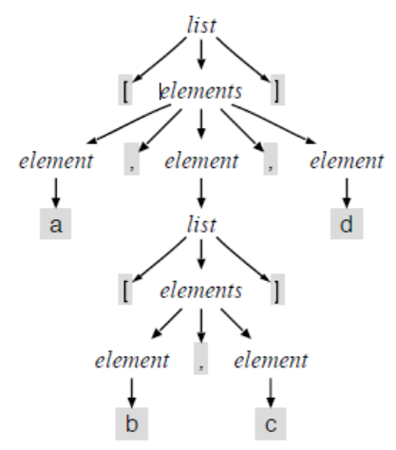
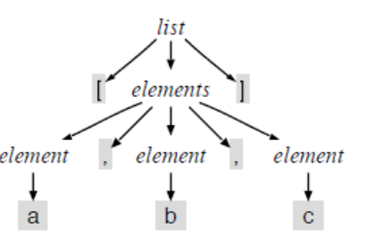
Parse Trees
1. Parse tree for [a,b,c]
2. Parse tree for [a,[b,c],d]
grammar NestedNameList;
list : '[' elements ']’ ; // match bracketed list
elements : element (',' element)* ; // match comma-separated list
element : NAME | list ; // element is name or nested list
NAME : ('a'..'z' |'A'..'Z' )+ ; // NAME is sequence of >=1 letter.

Slide 49
Implementation
Here is a loop that pulls tokens out, until it returns a token with type EOF_TYPE:
ListLexer lexer = new ListLexer(args[0]);
Token t = lexer.nextToken();
while ( t.type != Lexer.EOF_TYPE ) {
System.out.println(t);
t = lexer.nextToken();
}
System.out.println(t); // EOF
https://theswissbay.ch/pdf/Gentoomen%20Library/Programming/Pragmatic%20Programmers/Language%20Implementation%20Patterns.pdf
Page: 51

Slide 50
Example
Write a program to accept a C++ program as input and generate parse tree for the program
Run ANTLR to generate a lexical analyzer (lexer) and a parser for C++ .
Give a C++ program to your C++ compiler to generate parse and depict the parse tree for the program.
You may generate lexer and parser for other languages such as C# , Java, and Python.
Your code could be either in Python, or C# language,

Slide 51
Example
Run ANTLR to generate a lexical analyzer (lexer) and a parser for C++.
First, we have to move the grammar of C++ language (CPP14.g4) to C:\javalibs folder.
Now, we have to generate lexer & parser for the C++ by the Python language with this command in cmd:
java –jar ./antlr-4.8-complete.jar –Dlanguage=Python3 CPP14.g4

Slide 52
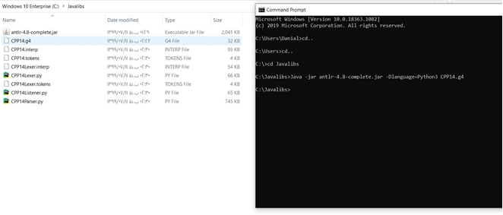
Example
As you seen below:
Files generated

Slide 53
Example
Give a C++ program to your C++ compiler to generate parse and depict the parse tree for the program.
We write a python code to generate lexer & parser for the file ‘test.cpp’ that is in the main folder of our python code.

Slide 54
Example
from antlr4 import CommonTokenStream, FileStream, ParseTreeWalker
from CPP14Lexer import CPP14Lexer
from CPP14Listener import CPP14Listener
from CPP14Parser import CPP14Parser
if __name__ == '__main__':
input_stream = FileStream('./test.cpp')
lexer = CPP14Lexer(input_stream)
stream = CommonTokenStream(lexer)
parser = CPP14Parser(stream)
tree = parser.translationunit()
listener = CPP14Listener()
walker = ParseTreeWalker()
walker.walk(listener, tree)
print(tree.getRuleIndex())
#Use FileStream to read the program file.
#Generate lexer from the fileStream object.
#Use CommonTokenStream to get tokens from the values #read in Lexer.
#Generate parser to create the parse tree from tokens.
#Use listener & walker to navigate the parsing tree.
#Listener listen when the walker enters or exits from each #non-terminal rule.

Slide 55
Regular expressions grammar
grammar MyGrammar;
/* * Parser Rules */
expr: expr op=(MUL | DIV) expr #mulDiv
| expr op=(ADD | SUB) expr #addSub
| number | ‘(‘expr’)’ #num
;
/* * Lexer Rules */
fragment DIGIT: [0 – 9];
fragment LETTER: [a – zA – Z];
INT: DIGIT +;
FLOAT: DIGIT + ‘.’
DIGIT +;
STRING_LITERAL: ‘\”.* ? ‘\”;
NAME: LETTER(LETTER | DIGIT) * ;
IDENTIFIER: [a-zA-Z0-9]+;
MUL: ‘*’;
DIV: ‘/’;
ADD: ‘+’;
SUB: ‘-‘;
WS: [\t\r\n]+ -> skip;

Slide 56
Example 1: Generating a Lexer
In our grammar file, say ScriptLexer.g4, we have:
// Name our lexer (the name must match the filename)
lexer grammar ScriptLexer;
// Define string values - either unquoted or quoted
STRING : ('a'..'z'|'A'..'Z'|'0'..'9'|'_'|'@')+ |
('"' (~('"' | '\\' | '\r' | '\n') | '\\' ('"' | '\\'))* '"') ;
// Skip all spaces, tabs, newlines
WS : [ \t\r\n]+ -> skip ;
// Skip comments
LINE_COMMENT : '//' ~[\r\n]* '\r'? '\n' -> skip ;
// Define punctuations
LPAREN : '<' ;
RPAREN : '>' ;
EQUALS : '=' ;
SEMICO : ';' ;
ASSIGN : ':=' ;
https://imjching.com/writings/2017/02/16/lexical-analysis-with-antlr-v4/

Slide 57
Example 1: Generating a Lexer
Now that we have our grammar file, we can run the ANTLR tool on it to generate our lexer program.
antlr4 ScriptLexer.g4
This will generate two files:
ScriptLexer.java (the code which contains the implementation of the FSM together with our token constants) and
ScriptLexer.tokens.
Now we will create a Java program to test our lexer: TestLexer.java
https://imjching.com/writings/2017/02/16/lexical-analysis-with-antlr-v4/

Slide 58
Example 1: Generating a Lexer
import java.io.File;
import java.io.FileInputStream;
import org.antlr.v4.runtime.ANTLRInputStream;
import org.antlr.v4.runtime.Token;
public class TestLexer {
public static void main(String[] args) throws Exception {
System.out.println("Parsing: " + args[0]);
FileInputStream fis = new FileInputStream(new File(args[0]));
ANTLRInputStream input = new ANTLRInputStream(fis);
ScriptLexer lexer = new ScriptLexer(input);
Token token = lexer.nextToken();
while (token.getType() != ScriptLexer.EOF) {
System.out.println("\t" + getTokenType(token.getType()) +
"\t\t" + token.getText());
token = lexer.nextToken();
}
}
private static String getTokenType(int tokenType) {
switch (tokenType) {
case ScriptLexer.STRING:
return "STRING";
case ScriptLexer.LPAREN:
return "LPAREN";
case ScriptLexer.RPAREN:
return "RPAREN";
case ScriptLexer.EQUALS:
return "EQUALS";
case ScriptLexer.SEMICO:
return "SEMICO";
case ScriptLexer.ASSIGN:
return "ASSIGN";
default:
return "OTHER";
}
}
}
https://imjching.com/writings/2017/02/16/lexical-analysis-with-antlr-v4/

Slide 59
Example 1: Generating a Lexer
We then compile our test program.
javac TestLexer.java
and if we try to run TestLexer and giving sample.script as an argument:
// Sample.Script : What to do in the morning
func morning <
name := "Jay";
greet morning=true input=@name;
eat cereals;
attend class="CS101";
>
// What to do at night
func night <
brush_teeth;
sleep hours=8;
>

Slide 60
Example 1: Generating a Lexer
We get the following:
java TestLexer sample.script
Parsing: sample.script
STRING func
STRING morning
LPAREN <
STRING name
ASSIGN :=
STRING "Jay"
SEMICO ;
STRING greet
STRING morning
EQUALS =
STRING true
STRING input
EQUALS =
STRING @name
SEMICO ;
STRING eat
STRING cereals
SEMICO ;
STRING attend
STRING class
EQUALS =
STRING "CS101"
SEMICO ;
RPAREN >
STRING func
STRING night
LPAREN <
STRING brush_teeth
SEMICO ;
STRING sleep
STRING hours
EQUALS =
STRING 8
SEMICO ;
RPAREN >

Slide 61
Regular Expression in C#
In C#, Regular Expression is a pattern which is used to parse and check whether the given input text is matching with the given pattern or not.
In C#, Regular Expressions are generally termed as C# Regex.
The .Net Framework provides a regular expression engine that allows the pattern matching.
Patterns may consist of any character literals, operators or constructors.
C# provides a class termed as Regex which can be found in System.Text.RegularExpression namespace.
This class will perform two things:
- Parsing the inputting text for the regular expression pattern.
- Identify the regular expression pattern in the given text.

Slide 62
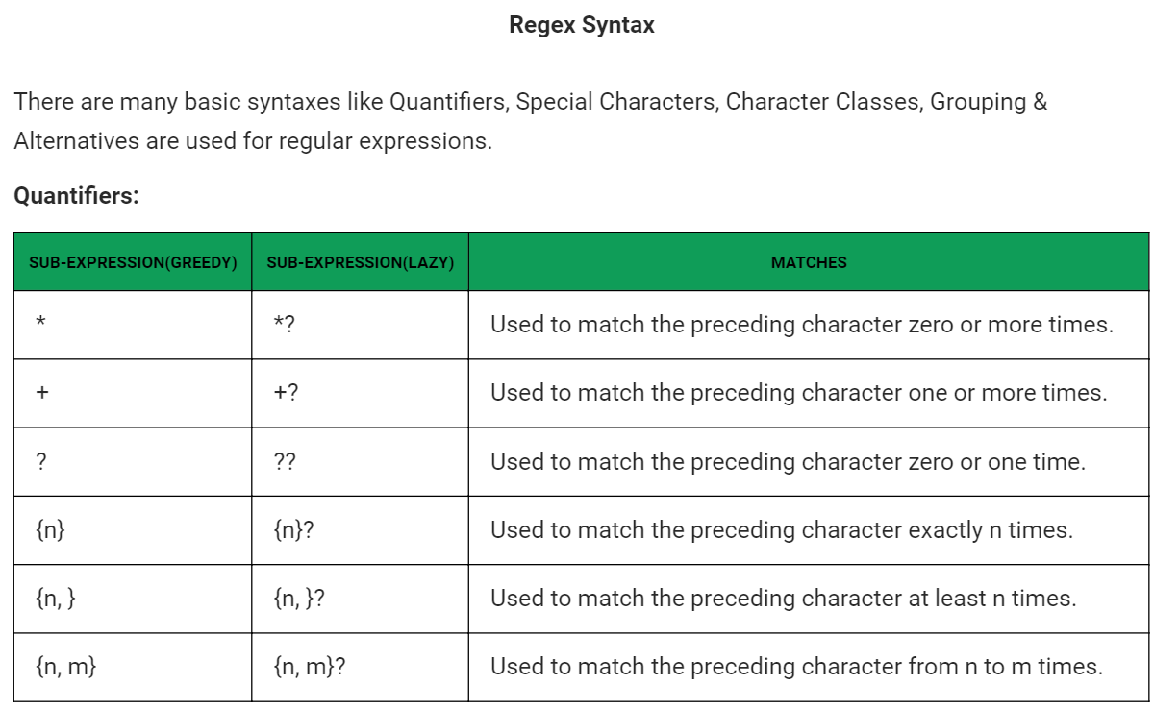
Regular Expression in C#

Slide 63
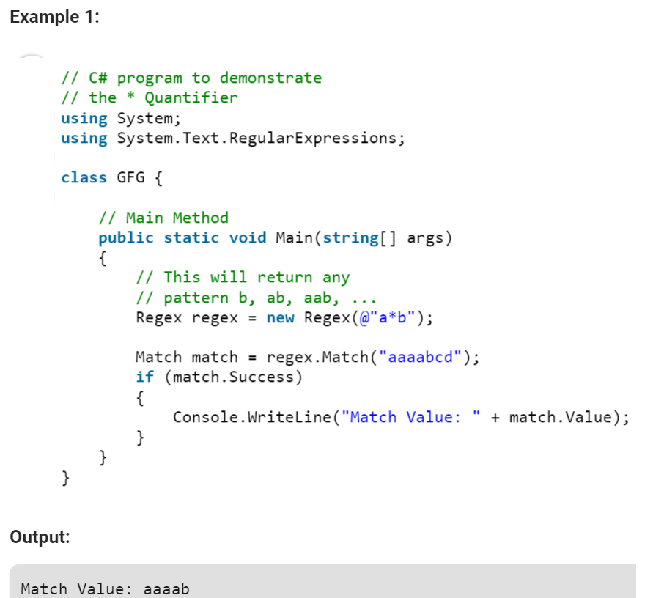
Regular Expression in C#

Slide 64
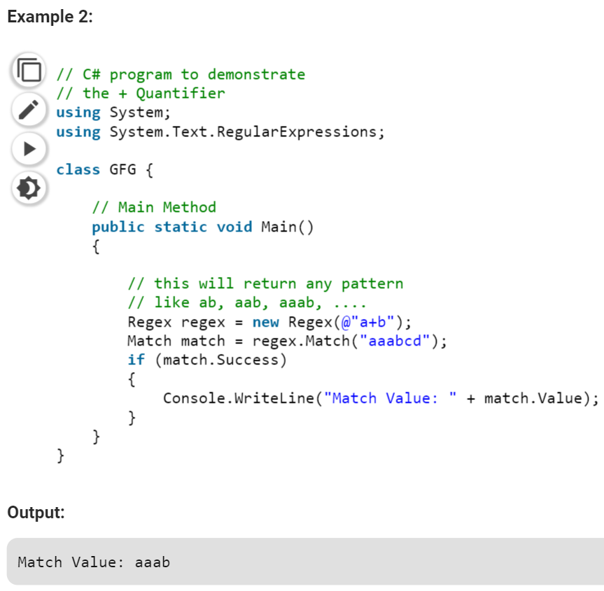
Regular Expression in C#

Slide 65
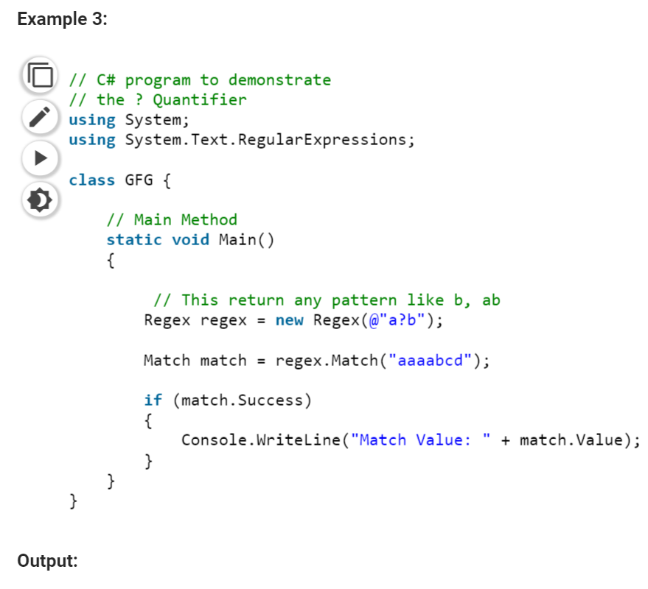
Regular Expression in C#

Slide 66
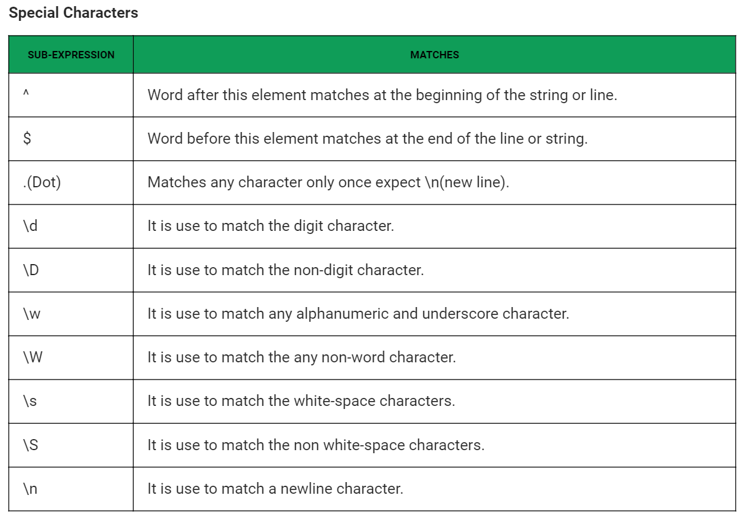
Regular Expression in C#

Slide 67
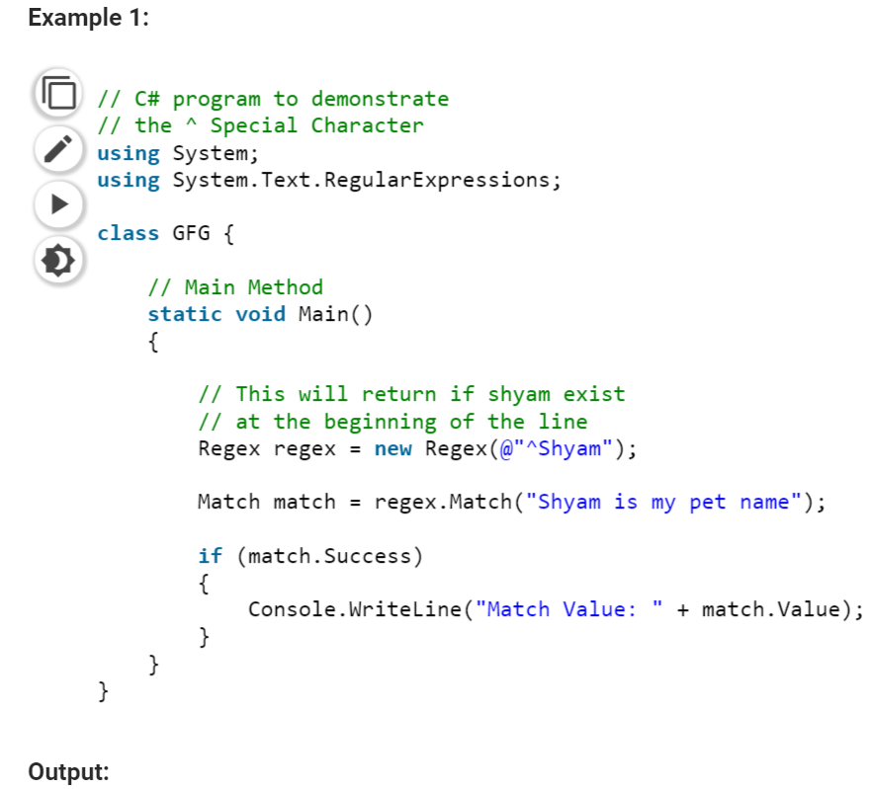
Regular Expression in C#

Slide 68
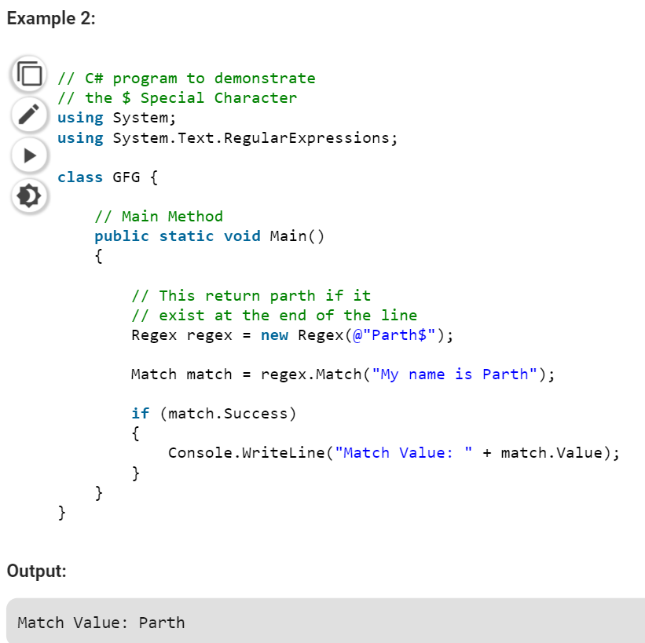
Regular Expression in C#

Slide 69
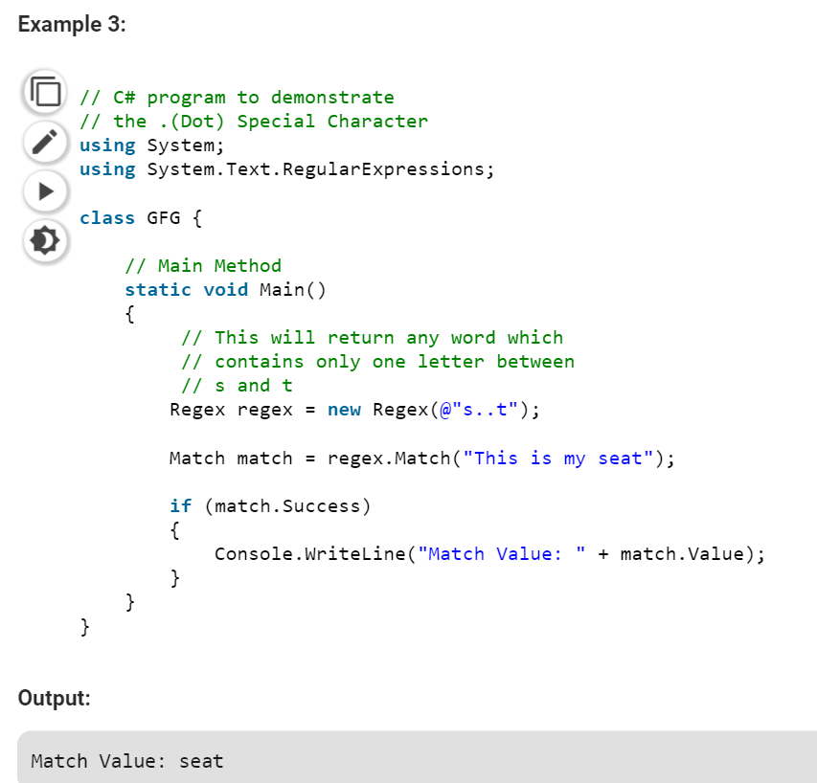
Regular Expression in C#

Slide 70
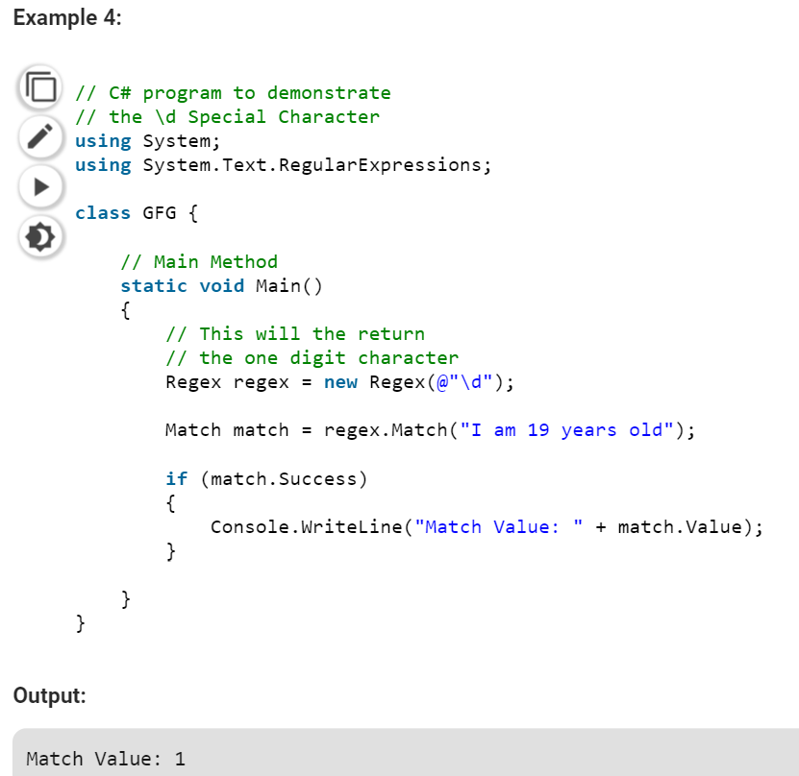
Regular Expression in C#

Slide 71
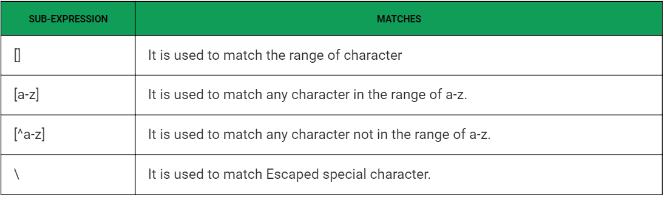
Regular Expression in C#

Slide 72
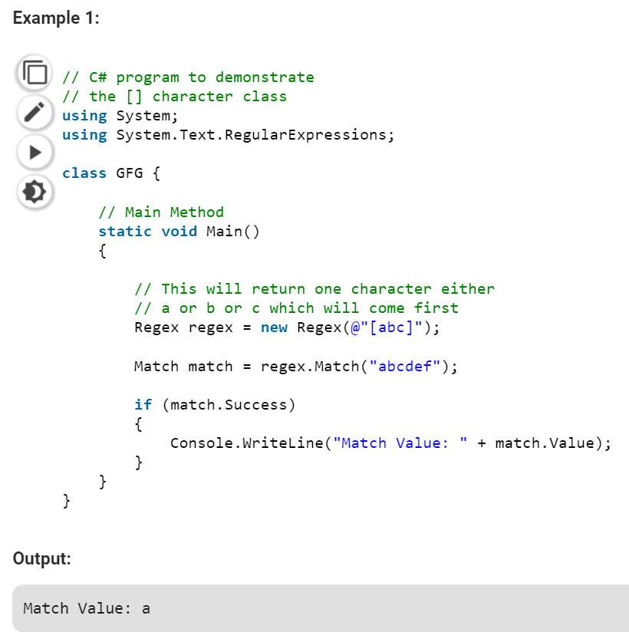
Regular Expression in C#

Slide 73
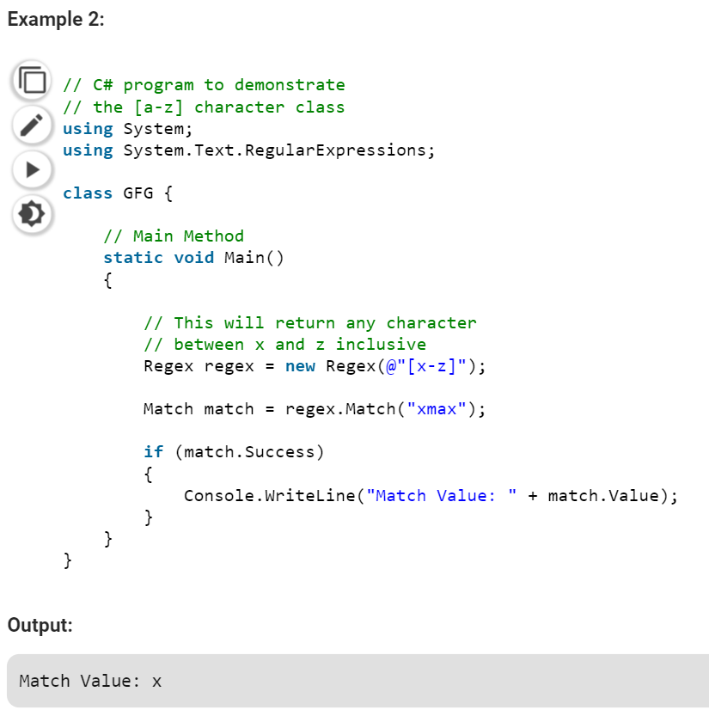
Regular Expression in C#

Slide 74
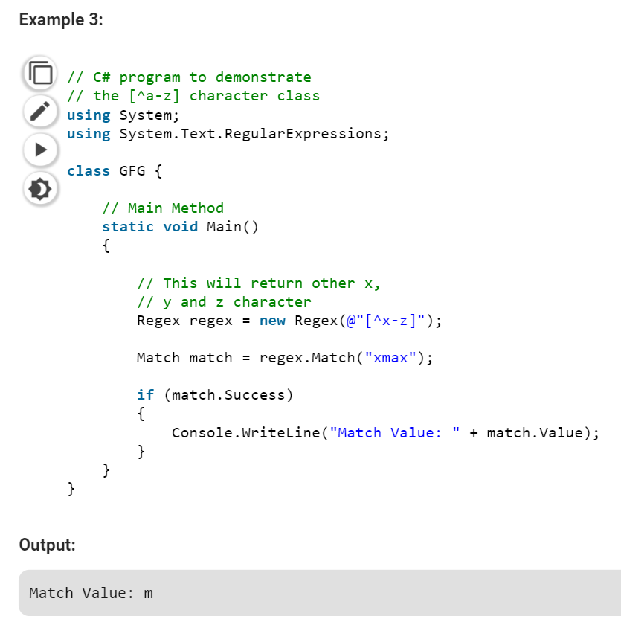
Regular Expression in C#

Slide 75
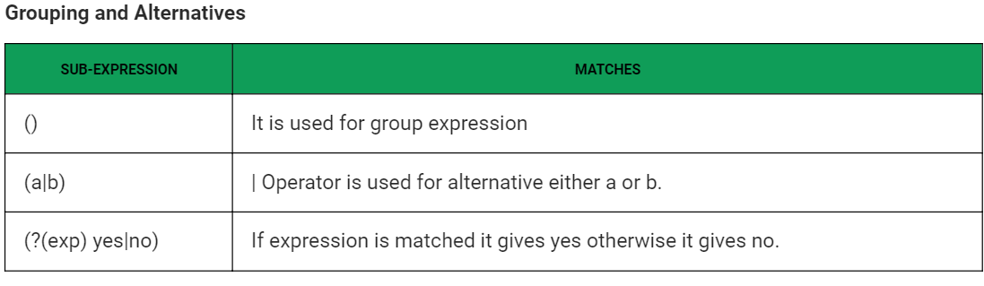
Regular Expression in C#

Slide 76
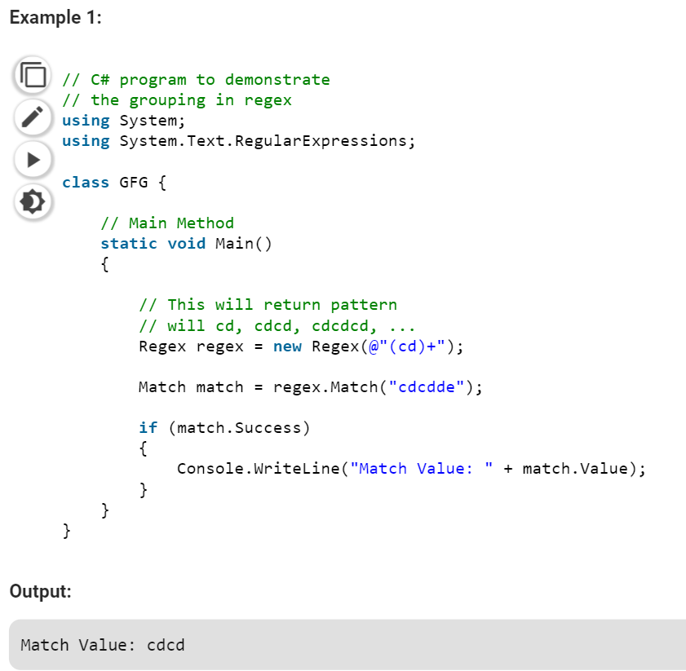
Regular Expression in C#

Slide 77
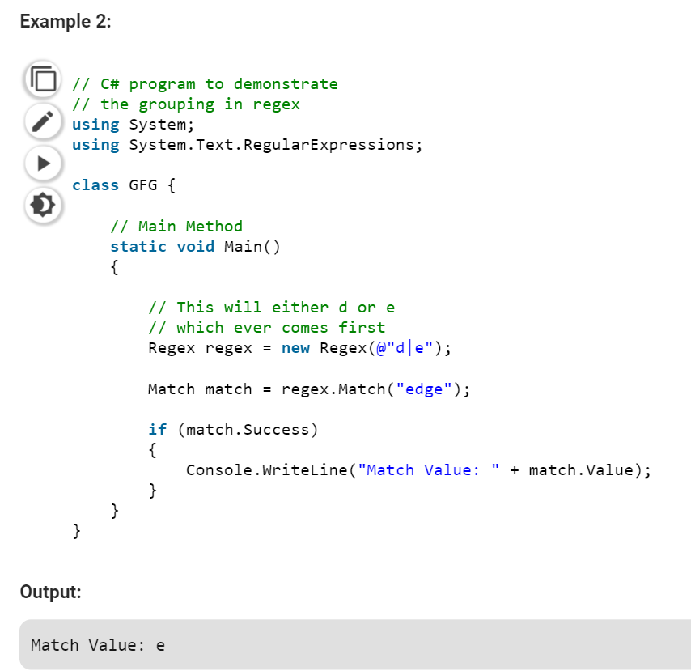
Regular Expression in C#

Slide 78
POSIX Standard
POSIX is a standard specified the IEEE.
POSIX standard is a widely used and accepted API for regular expression
Traditional Unix regular expression syntax followed common conventions that often differed from tool to tool.
The POSIX Basic Regular Expressions syntax was developed by the IEEE, together with an extended variant called Extended Regular Expression syntax.
These standards were designed mostly to provide backward compatibility with the traditional Simple Regular Expressions syntax, providing a common standard which has since been adopted as the default syntax of many Unix regular expression tools.

Slide 79
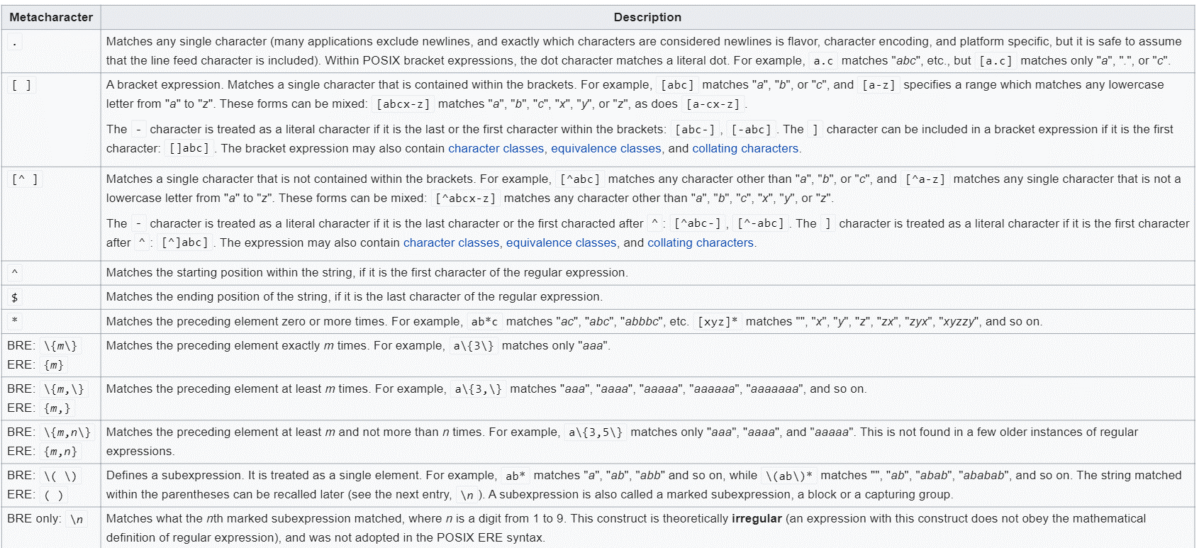
POSIX Standard

Slide 80
POSIX Standard
Examples:
.at matches any three-character string ending with "at", including "hat", "cat", and "bat".
[hc]at matches "hat" and "cat".
[^b]at matches all strings matched by .at except "bat".
^[hc]at matches "hat" and "cat", but only at the beginning of the string or line.
[hc]at$ matches "hat" and "cat", but only at the end of the string or line.
\[.\] matches any single character surrounded by "[" and "]" since the brackets are escaped, for example: "[a]" and "[b]".

Slide 81
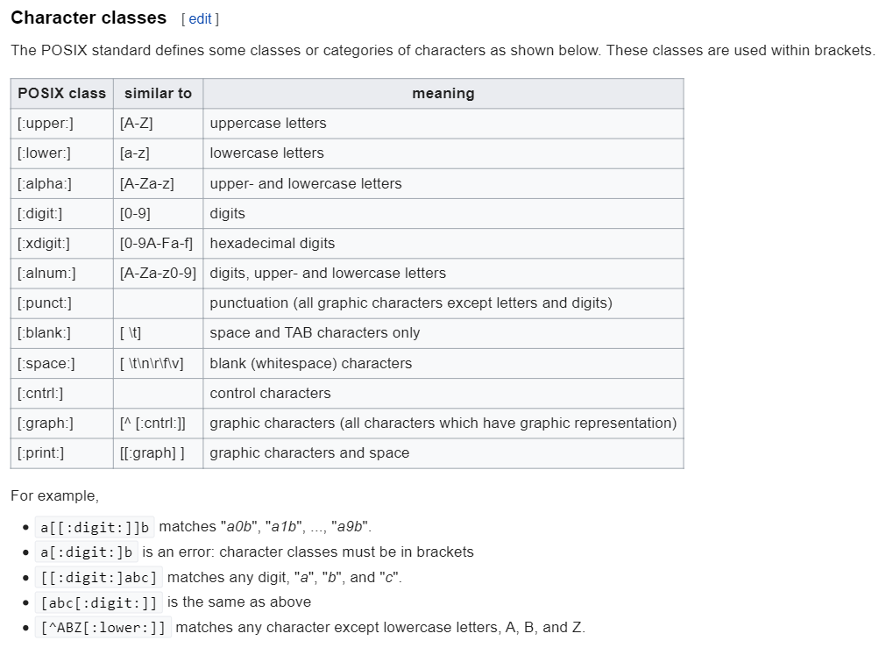
POSIX Standard

Slide 82
Example
Write a regular expression to describe inputs over the alphabet {a, b, c} that are in sorted order.
Because of sorting, we assume that inputs are like examples followed:
So, the regular expression is:
a*b*c*
aaabbbcc | abcc | bcccc | abb | aaabcc | aacc

Slide 83
Example
Write a regular expression to check whether a string starts and ends with the same character. Implement the regular expression in Python.
We have two cases:
If the string has just a single character, it has the condition we want, so the regExp is:
^[a-z]$
If the string has multiple characters, we have:
^([a-z]).*\1$
\1: match the same character that comes in the first position of the string
So, the final regExp we want is the combination of two cases mentioned:
^[a-z]$|^([a-z]).*\1$

Slide 84
Example
The python program to implement and test the regExp is shown below:
import re
regExp = r'^[a-z]$|^([a-z]).*\1$'
result = re.match(regExp, 'abba')
print(result)

Slide 85
Example
Write a regular expression to determine if a string is an ip address Rule: An ip address consists of 3 numbers, separated with two dots. The value of each number is 0-255 For example: 255.189.10.37 Correct and 256.189.89.9 is error. Write a C# or Python program to validate IP addresses.
Because we have 4 numbers that separated by .(dot), our regular expression that just accepts the valid ip address is:
((\d|[1-9]\d|1\d{2}|2[0-4]\d|25[0-5])\.){3}(\d|[1-9]\d|1\d{2}|2[0-4]\d|25[0-5])

Slide 86
Example
The python program to implement and test the regExp is shown below:
import re
regExp = r'((\d|[1-9]\d|1\d{2}|2[0-4]\d|25[0-5])\.){3}(\d|[1-9]\d|1\d{2}|2[0-4]\d|25[0-5])'
result = re.fullmatch(regExp, '192.168.1.12')
print(result)

Slide 87
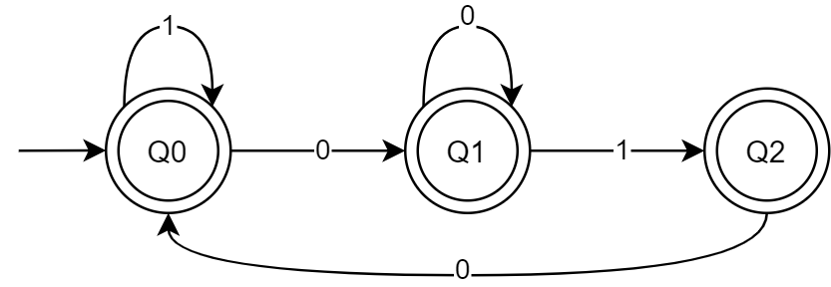
Example
Depict a DFA to accept all the binary strings, that do not include the substring “011”. write a lexer function to determine these strings.
The DFA should be like this:

Slide 88
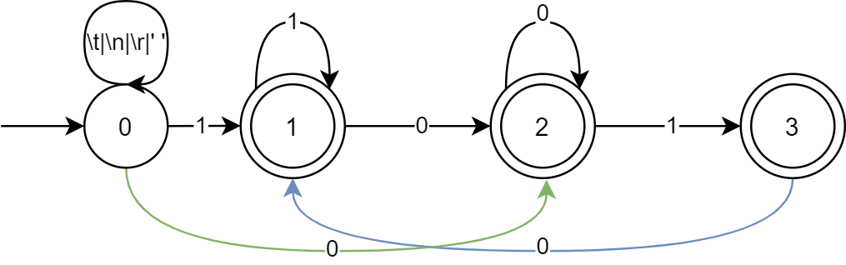
Example
Lexer function:
struct TokenType LexicalAnalyser(FILE * Source) {
enum Symbols LexiconType;
char NextChar, NextWord[80];
int State, Length;
static char LastChar = '\0';
static int RowNo = 0, ColNo = 0;
State = 0;
Length = 0;
while(!feof(Source)) {
if(LastChar) {
NextChar = LastChar;
LastChar = '\0';
} else {
NextChar = fgetc(Source);
}
NextWord[Length++] = NextChar;

Slide 89
Example
Lexer function:
case 0:
if (NextChar == ‘\n‘){
RowNo++ ; ColNo = 0;
} else
ColNo++;
if (Nextchar == ‘ ‘ || Nextchar == ‘\t‘ || Nextchar == ‘\n‘)
Length = 0;
else if ( Nextchar == ‘1‘) State = 1;
else if ( Nextchar == ‘0‘) State = 2;
else LexerError(NextWord, Length);
break;
case 1:
if ( Nextchar == ‘1‘) State = 1;
else if ( Nextchar == ‘0‘) State = 2;
else return "accepted";
break;

Slide 90
Example
Lexer function:
case 2:
if ( Nextchar == ‘1‘) State = 3;
else if ( Nextchar == ‘0‘) State = 2;
else return "accepted";
break;
case 3:
if ( Nextchar == ‘0‘) State = 1;
else return "accepted";
break;

Slide 91
Example
Write a function that removes all comments from a piece of CPP code.
Steps to do:
Create FileStream object for the input file.
Create lexer for the FileStream object
Get the first token by lexer.nextToken().
Check in the loop all of the tokens one by one not to be line comment or block comment & get next token.

Slide 92
Example
The python code to implement removing comments is shown below:
from antlr4 import *
from gen.CPP14Lexer import CPP14Lexer
def remove_comments(filename='test.cpp'):
input_stream = FileStream(filename)
lexer = CPP14Lexer(input_stream)
stream = CommonTokenStream(lexer)
token = lexer.nextToken()
new_file = open('test2.cpp', 'w')
while token.type != Token.EOF:
if token.type != lexer.BlockComment and token.type != lexer.LineComment:
new_file.write(token.text.replace('\r', ''))
token = lexer.nextToken()

Slide 93
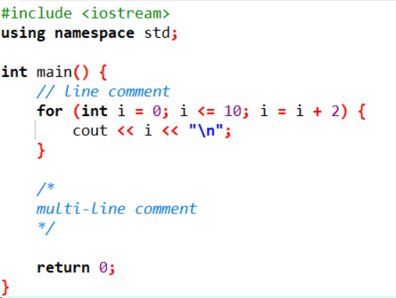
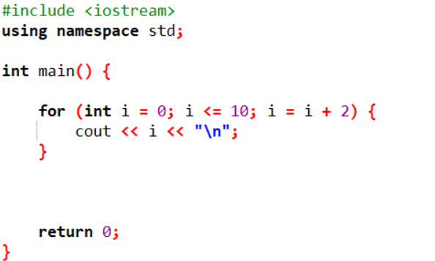
Example
That’s the result:
Before call remove_comment() After call remove_comment()

Slide 94
Example
Write a Python program, using ANTLR, to add your student number to all the comments within CPP programs.
We find both line comments & block comments and we add student id to it and save in new file named “test2.cpp”.

Slide 95
Example
The python code to implement removing comments is shown below:
input_stream = FileStream('test.cpp')
lexer = CPP14Lexer(input_stream)
stream = CommonTokenStream(lexer)
token = lexer.nextToken()
new_file = open('test2.cpp', 'w')
while token.type != Token.EOF:
if token.type == lexer.BlockComment:
text_to_write = token.text.replace('\r', '').replace("*/", "97521135\n*/")
new_file.write(text_to_write)
elif token.type == lexer.LineComment:
new_file.write(token.text.replace('\r', '') + " 97521135")
else:
new_file.write(token.text.replace('\r', ''))
token = lexer.nextToken()

Slide 96
Example
Write a Python program, using ANTLR, to detect email addresses.
First, we have to write a grammar for emails in Email.g4:
grammar Email;
email: LITERAL ATSIGN LITERAL (DOT LITERAL)+ ;
WS: [ \t\r\n] -> skip ;
LITERAL : [a-zA-Z]+ [0-9]*;
ATSIGN: '@' ;
DOT: '.' ;

Slide 97
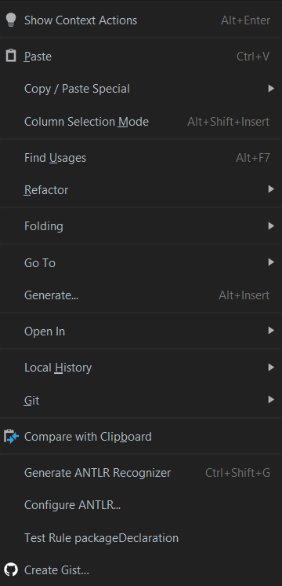
Example
Write a Python program, using ANTLR, to detect email addresses.
Now, we have to generate lexer & parser from the grammar we’ve wrote, by right-click on the grammar file & select “Generate ANTLR Recognizer”

Slide 98
Example
And we use python code to use lexer to evaluate the email is right or not.
from antlr4 import *
from gen.EmailLexer import EmailLexer
input_stream = InputStream('danibazi9@gmail.com')
try:
lexer = emailLexer(input_stream)
stream = CommonTokenStream(lexer) print("The input email is correct")
print("The tokens are:") token = lexer.nextToken()
while token.type != Token.EOF:
print(token.text)
token = lexer.nextToken() except:
print("The input email is not in the proper format")

Slide 99

Assignment 2
Subject : Lexical Analysis
Deadline: 1399/7/28
Mark: 5 out of 100.

Slide 100

Assignment 2
Write a regular expression to describe inputs over the alphabet {a, b, c} that are in sorted order.
Write a regular expression to check whether a string starts and ends with the same character. Use ANTLR4 to implement the regular expression in Python.
Write a regular expression to determine if a string is an ip address Rule: An ip address consists of 3 numbers, separated with two dots. The value of each number is 0-255 For example: 255.189.10.37 Correct and 256.189.89.9 is error. Write a C# or Python program to validate IP addresses.
Depict a DFA to accept all the binary strings, that do not include the substring “011”. write a lexer function to determine these strings.
Write a function that removes all comments from a piece of CPP code.

Slide 101


